Slide 1
Introduction to Data Structure and Algorithms
Fahad Burhan Ahmad

Slide 2
Algorithm Analysis
How Running Time is Estimated?

Slide 3
How Running Time is Estimated?
An algorithm, in general, consists of
  Some initialization instructions
  Looping
  Decision-making
  Other ‘bookkeeping’ operations such as
    incrementing array indexes
    computing array indexes
    setting pointers in data structures etc.
Some of these tasks are independent of the size of inputs some are not
  e.g. number of loops may be influenced by the size of input
  execution time of one pass through a loop may be much more than the execution time in another pass
  One algorithm may have longer loop bodies than another algorithm for the same problem

Slide 4
How Running Time is Estimated?
It may not be good idea to measure the execution time by means of number of loops in an algorithm
So we will ignore initialization, loop control and other bookkeeping and just count the basic operations performed by an algorithm e.g.
  To multiply two matrices, the basic operation is multiplication
  To sort an array, the basic operation is the comparison of array elements
Thus the no. of basic operations involved in an algorithm is a good measure of the execution time of an algorithm and a good criterion for comparing several algorithms

Slide 5
How Does Memory Requirement matter?
To solve a certain problem, it is obvious that data are stored in main memory
Apart from this storage requirement, an algorithm may demand extra space as
  to store intermediate data
  Some data structure like stack/queue etc.
  As memory is expensive thing in computation, a good algorithm should solve a problem with as minimum as possible memory
    Processor – memory speed bottleneck
Memory run-time trade off
  We can reduce execution time by increasing memory usage or vice versa
  E.g. execution time of a searching algorithm over the array can be greatly reduced by using some other arrays to index elements in main arrays

Slide 6
Why Simplicity and Clarity is Considered?
A quantitative measurement in algorithm analysis
Algorithm is usually expressed in English like language or in a pseudo code so that it can be easily understood
This matters because it is then easy to analyze quantitatively analyze over other parameters such as
  Easy to implement (by a programmer)
  Easy to develop a better version or
  Modify for other purposes etc.

Slide 7
Concept of Optimality
It is observed that whatever be the clever procedure, we follow, an algorithm cannot be improved beyond a certain point
Three cases that may arise specific to an algorithm
  Best Case – minimum execution time
  Average Case – indicates the behavior of an algorithm in an average situation
  Worst Case – maximum execution time

Slide 8
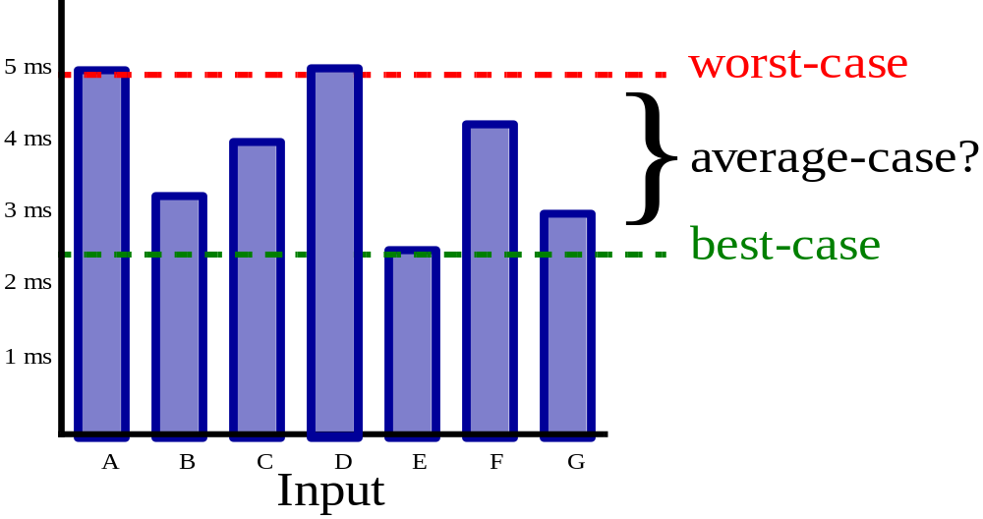
Complexity
Execution time, memory requirement and optimality can be expressed quantitatively in term of size of input n.
Expressing the execution time in term of time say T(n) is the time complexity of an algorithm

Slide 9
Complexity Analysis
Best case analysis
  Given the algorithm and input of size n that makes it run fastest (compared to all other possible inputs of size n), what is the running time?
Worst case analysis
  Given the algorithm and input of size n that makes it run slowest (compared to all other possible inputs of size n), what is the running time?
    A bad worst-case complexity doesn't necessarily mean that the algorithm should be rejected.
Average case analysis
  Given the algorithm and a typical, average input of size n, what is the running time?

Slide 10
Solved Examples

Slide 11
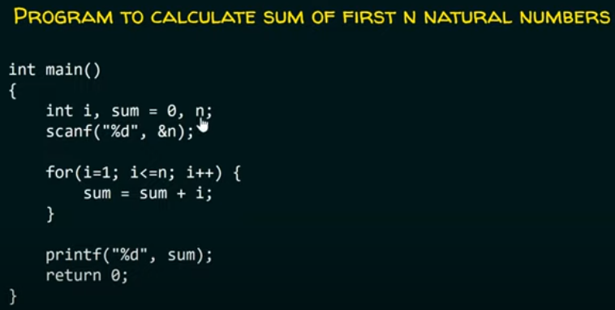
Problem: 1

Slide 12

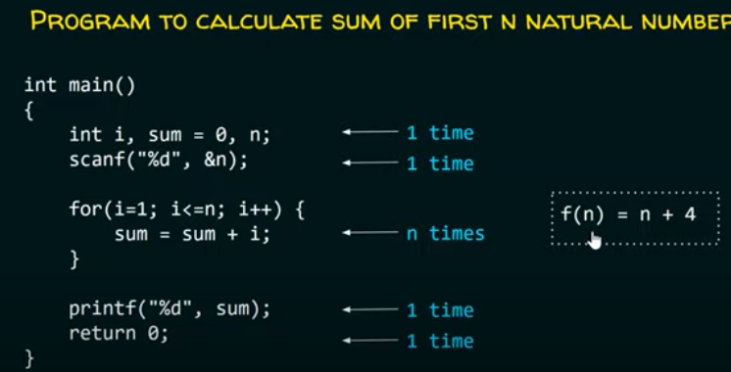
Solution: 1

Slide 13
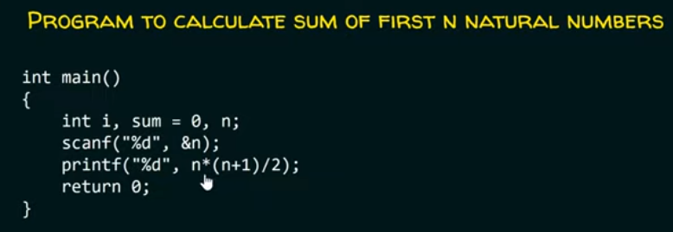
Problem: 2

Slide 14
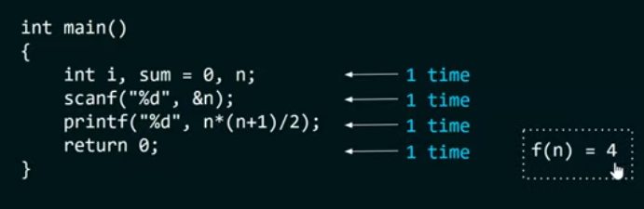
Solution: 2

Slide 15
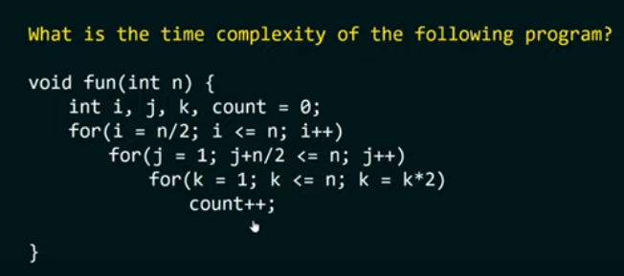
Problem: 3

Slide 16
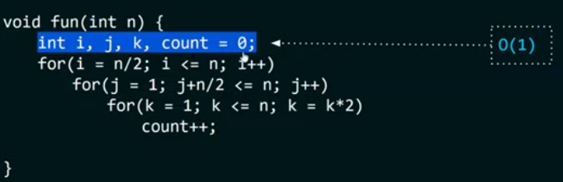
Solution 3 : Step 1

Slide 17
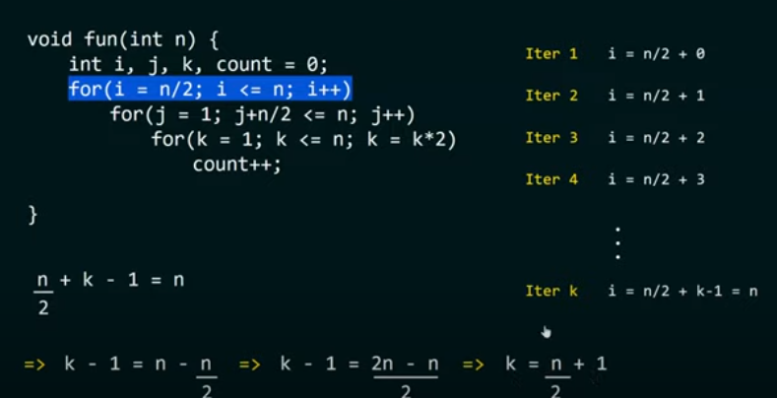
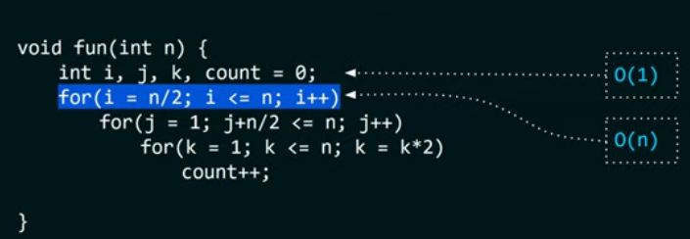
Solution3 : Step 2

Slide 18
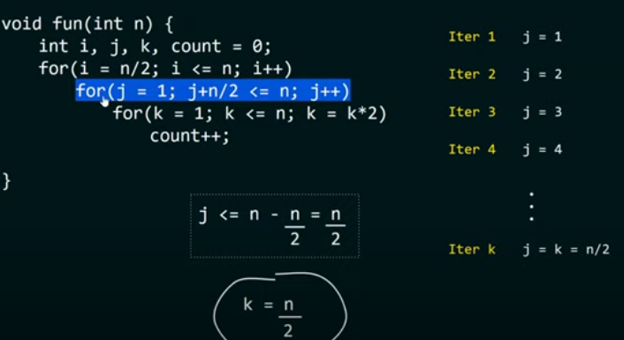
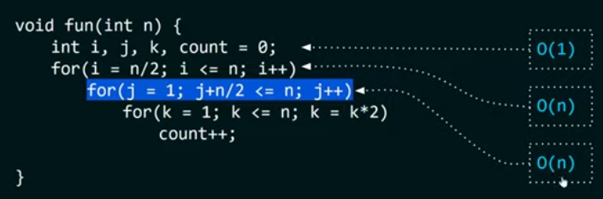
Solution3 : Step 3

Slide 19
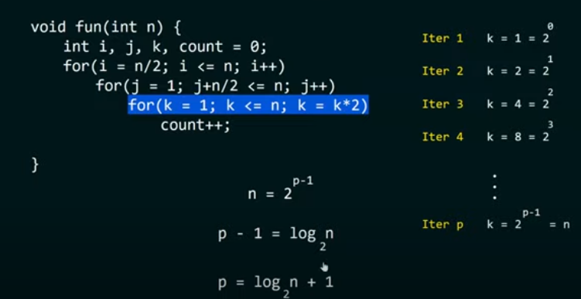
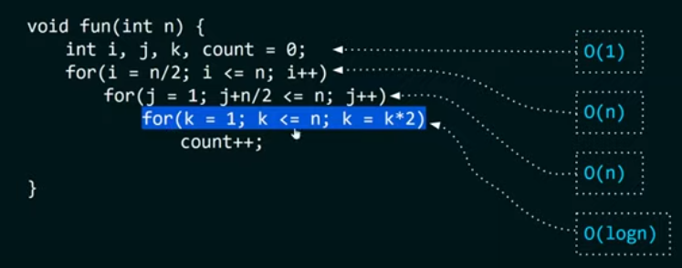
Solution 3 : Step 4

Slide 20
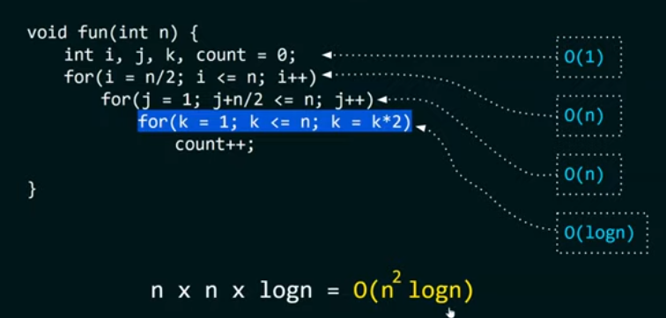
Overall complexity

Slide 21
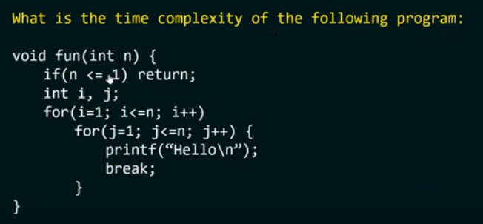

Problem:4

Slide 22
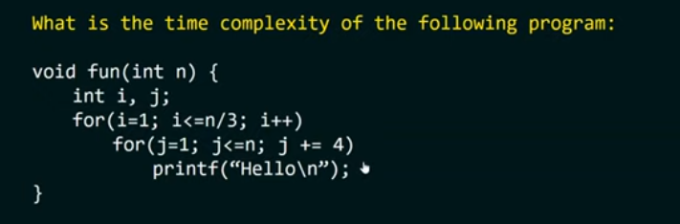
Problem:5

Slide 23
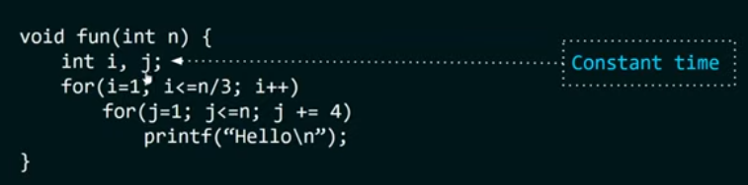
Solution: 5:: Step 1

Slide 24
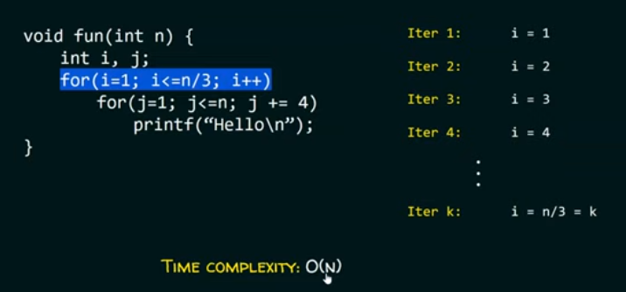
Solution:5:: Step 2

Slide 25
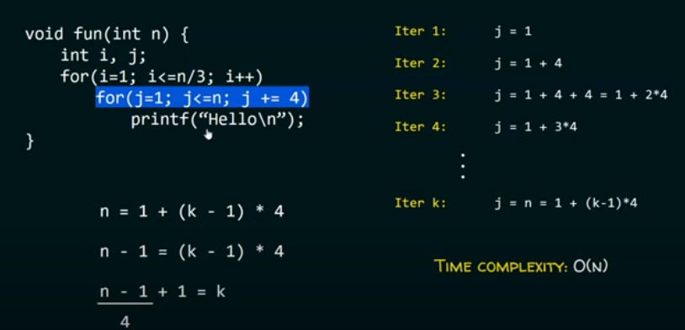
Solution:5 :: Step 3

Slide 26
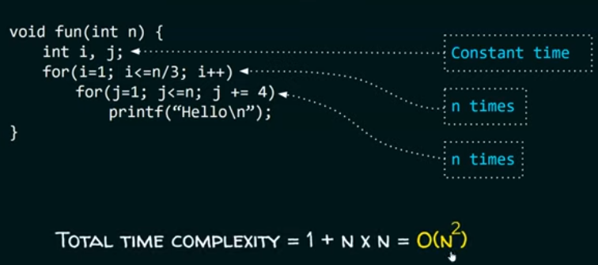
Overall Complexity

Slide 27
Space Complexity

Slide 28
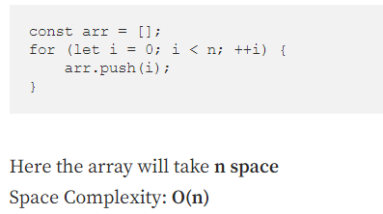
Problem 1:

Slide 29
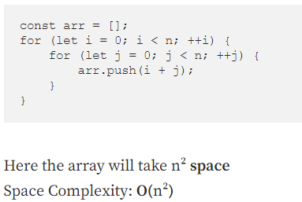
Problem: 2

Slide 30
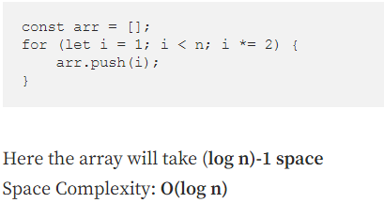
Problem: 3

Slide 31
Summary
Any Questions?

